Slide 1

BMS INSTITUTE OF TECHNOLOGY and MANAGEMENT (An Autonomous institution under VTU, Belagavi) Avalahalli Doddaballapura Main Road, Yelahanka, Bangalore-64 Department of MCA Major Project [22MCA403]
DIGITALIZATION OF THE MCA DEPARTMENT
NAME : SHASHANK K USN: 1BY22MC047
DATE OF PRESENTATION: 13/08/2024
GUIDE:DR SHIVAKUMARA T
ASSISTANT PROFFESER OF MCA DEPT
BMSIT

Slide 2
Topics To be discussed
Introduction
Literature survey
Existing & Proposed System
System Architecture
Class Diagrams
Use Case Diagrams
System Design & Database Design
Test Cases
User-Screenshots
Open For Discussion
Conclusion

Slide 3
1.Introduction
The digitalization of the MCA Department represents a strategic initiative aimed at optimizing resource utilization and improving overall efficiency. The Mca department requires a lot of documentation work such as course registration for the upcoming mca juniors In this Project we can store the students who have passed out from the mca department i.e. alumni of the previous batch student’s and we can also add the current students who will be passing out this year and we can search for the students by registering them
Before login the students need to register themselves and then they can login to enter the further details and this way we can add the student details for the course registration and we can assist the students to give the feedback on the department website in the contact us page so that the students can give the review on the department website which helps the department website and makes it more effective in storing the data for future

Slide 4
Frontend technologies like HTML5, CSS3, and JavaScript form the foundation for developing intuitive and visually appealing interfaces for both educational content delivery and administrative functions.
HTML5 provides a structured approach to content presentation, facilitating clarity and accessibility across different devices and screen sizes.
CSS3 enhances the aesthetics of the department's digital platforms, ensuring a cohesive and engaging user interface through advanced styling and layout techniques.
JavaScript, meanwhile, enables dynamic interactions and real-time updates, enriching user engagement and functionality.
Backend technologies play a pivotal role in supporting the robust infrastructure required by the MCA Department.
Python, renowned for its versatility and readability, serves as the primary programming language underpinning backend development.
Django, a powerful Python framework, provides the necessary tools for rapid application development and secure data.
Furthermore, the digitalization of administrative processes within the MCA Department aims to streamline workflows, reduce paperwork, and improve operational efficiency.

Slide 5
2. Literature survey
The digitalization of departments, including MCA departments, is increasingly recognized for enhancing operational efficiency and user experience through integrated hardware and software systems.
Key components include modern hardware with multicore processors, sufficient RAM, and compatibility with major operating systems and web browsers.
Software stacks typically include HTML5 for structured content, CSS3 for visual appeal, JavaScript for dynamic frontend functionalities,
Django for secure backend operations leveraging Python, and SQL lite databases for reliable data management.

Slide 6
2.1. Literature Review
Sharma, M., & Kumar, V. (2019). "Performance Evaluation of Multicore Processors in Modern Computing Systems." Journal of Computer Engineering and Information Technology. This paper discusses how multicore processors enhance computational efficiency and support multi-threaded applications.
This paper evaluates the impact of multicore processors on computational efficiency and multi-threaded application support.
Multicore processors, which integrate multiple processing units into a single chip, are pivotal in enhancing computing performance by enabling parallel processing.
Key Findings Parallelism: Multicore processors facilitate parallel processing, where multiple tasks can be executed simultaneously.
This is crucial for applications requiring significant computational power, such as scientific simulations and complex data processing.
Performance Improvement: The paper demonstrates that multicore processors significantly improve performance metrics like processing speed and system responsiveness.
Applications optimized for multicore systems benefit from reduced execution time and better handling of simultaneous tasks.

Slide 7
2. Khan, M. A., & Sultana, R. (2020). "Impact of RAM Size on System Performance and Reliability.“
International Journal of Computer Applications Summary: The paper explores how the amount of RAM affects system performance and reliability, focusing on applications requiring large datasets and high computational resources.
Key Findings System Performance: Increasing RAM size directly impacts system performance by allowing more data to be processed concurrently.
Larger RAM sizes reduce the need for swapping data to disk, which can significantly enhance speed and responsiveness.
Application Handling: The study highlights how RAM size influences the system’s ability to handle large-scale applications, including complex simulations and large databases.
Reliability: Sufficient RAM improves system stability by minimizing crashes and slowdowns associated with insufficient memory. The paper discusses how inadequate RAM can lead to frequent application failures and degraded performance.
Optimization: Recommendations include optimizing software to efficiently use available memory and upgrading hardware to meet increasing demands of modern applications.
Implications: The findings emphasize the critical role of RAM in maintaining high performance and reliability in computing systems, particularly for memory-intensive applications.

Slide 8
3. Harris, C., & Walters, P. (2018). "Advancements in HTML5 and CSS3 for Modern Web Development." IEEE
Access Summary : This paper reviews the advancements in HTML5 and CSS3, focusing on their impact on web content structuring and design.
Key Findings: HTML5 Features: The paper discusses new HTML5 elements and APIs, such as <article>, <section>, which enhance content organization and interactive capabilities.
CSS3 Enhancements: CSS3 introduces features like media queries, flexible box layouts, and CSS animations, which improve web design responsiveness and visual appeal.
Cross-Browser Compatibility: HTML5 and CSS3 offer improved compatibility across different browsers and devices, enabling a more consistent user experience.
Performance: The paper notes that HTML5 and CSS3 contribute to faster page load times and more efficient rendering, thanks to their optimized design and reduced need for external plugins.
Implications : The advancements in HTML5 and CSS3 play a significant role in modern web development, enabling richer, more interactive, and visually appealing web experiences.

Slide 9
4. Smith, J., & Nguyen, T. (2021). "JavaScript Frameworks and Their Impact on Web Application Development." ACM
Computing Surveys Summary : This research explores various JavaScript frameworks and their influence on web application development.
Key Findings : Frameworks Overview: The paper examines popular JavaScript frameworks such as Angular, React, and Vue.js, highlighting their unique features and use cases.
Development Efficiency: JavaScript frameworks improve development efficiency by providing pre-built components, state management, and tools for handling complex functionalities.
Performance: The study evaluates how different frameworks impact application performance, including factors like rendering speed and responsiveness.
Community and Ecosystem: It also discusses the importance of community support and ecosystem maturity in choosing a framework, as these factors influence long-term maintainability and development.
Implications:The research underscores the importance of selecting the right JavaScript framework based on project requirements, performance needs, and development efficiency.

Slide 10
5. Johnson, R., & Patel, S. (2017). "A Comparative Study of Web Frameworks: Django vs. Other Frameworks."
Journal of Software Engineering and Applications Summary : This paper compares Django with other web frameworks, focusing on its security and performance attributes.
Key Findings : Django Features: The paper highlights Django’s strengths, such as its built-in security features (e.g., protection against CSRF attacks), its ORM (Object-Relational Mapping), and its scalability.
Comparison: It compares Django with other frameworks like Flask and Ruby on Rails, discussing differences in architecture, ease of use, and performance .
Use Cases: The study identifies scenarios where Django is particularly effective, such as in applications requiring robust security and rapid development.
Implications: The comparative analysis provides insights into why Django is a preferred choice for many developers, particularly for applications needing strong security and scalability.

Slide 11
6. Brown, L., & Zhang, Y. (2019). "Performance Analysis of SQLite for Mobile and Web Applications."
Database Systems Journal Summary : The paper evaluates SQLite’s performance across various application scenarios, focusing on mobile and web applications .
Key Findings: SQLite Overview: SQLite is a lightweight, serverless database engine that is ideal for applications requiring embedded databases.
Performance Metrics: The paper provides performance benchmarks for SQLite, highlighting its efficiency in handling small to medium-sized datasets and its low resource consumption.
Use Cases: It discusses use cases where SQLite excels, such as in mobile apps and small-scale web applications, due to its simplicity and ease of integration.
Limitations: The study also addresses SQLite’s limitations, including its reduced performance for high-concurrency scenarios compared to more robust database systems.
Implications: SQLite is suitable for applications with moderate data handling needs, offering simplicity and efficiency while being limited in high-demand environments.

Slide 12
7. Lee, J., & Kim, H. (2020). "Optimizing System Integration for Enhanced Operational Efficiency."
International Journal of Systems Integration Summary : This paper discusses best practices for integrating hardware and software to boost operational efficiency.
Key Findings : Integration Strategies: The study outlines strategies for effective system integration, including standardization, modular design, and interoperability.
Efficiency Gains: It demonstrates how optimized integration reduces system redundancy, enhances data flow, and improves overall performance.
Case Studies: The paper includes case studies showing successful integration in various sectors, highlighting the benefits achieved through improved coordination between hardware and software components.
Implications:Optimized system integration is crucial for maximizing operational efficiency, reducing costs, and enhancing performance across various domains.

Slide 13
3. Existing System
The current system in MCA departments often relies on traditional manual methods for appointment scheduling and data management.
It may lack integration, resulting in inefficiencies, data redundancies, and delays in patient care and administrative processes.
This system typically operates on basic hardware setups with limited computing power and outdated software tools, hindering optimal departmental functioning and user satisfaction.
3.1 Proposed System
The proposed digitalization initiative aims to revolutionize MCA department operations by implementing a comprehensive system.
This includes deploying modern desktops or laptops with advanced hardware specifications, compatible with diverse operating systems and web browsers.
Software components will feature HTML5 for structured content, CSS3 for enhanced user interfaces, Django for robust backend development using Python, and SQL databases for secure data storage and retrieval.
This integrated approach seeks to streamline operations, improve patient care delivery, and ensure scalability and security for future departmental needs.

Slide 14
4 Hardware and Software requirements
4.1 Hardware Requirements:
Ram - 4GB to 16GB
Processer – Pentium i5 and above
4.2 Software Requirements:
VS Code
PyCharm

Slide 15
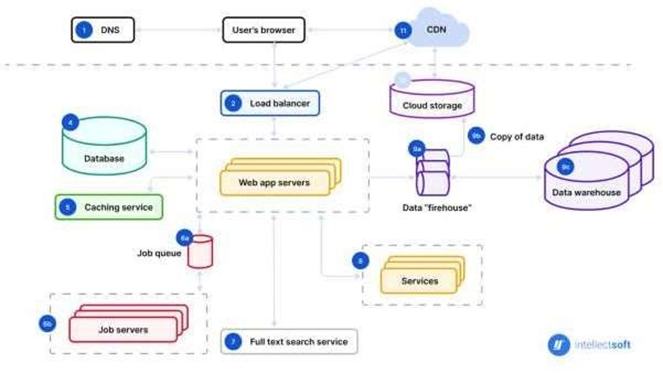
4. System Architecture
The system architecture for digitalizing MCA departments integrates advanced hardware and modern software components to enhance operational efficiency and educational experiences.
This architecture typically includes :
Hardware: Modern multicore processors, ample RAM, and reliable storage systems to support high-performance computing and data management.
Frontend Technologies: HTML5 and CSS3 for creating structured and visually appealing web interfaces, enabling efficient content presentation and user interaction .
Backend Technologies: Django for secure and scalable backend operations, managing data and application logic effectively .
Database: SQLite for reliable data storage and management, ensuring seamless integration with web applications.
Figure 4.2.1 System Architecture

Slide 16
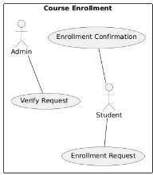
5. Class Diagrams
5.1 Dataflow diagram
Figure 5.1.1 Course Enrolment Data Flow Diagram
Description:
This use case diagram represents the process of course enrolment.
It involves two primary actors: the Admin and the Student.
The student initiates the process by submitting an Enrolment Request.
The admin then verifies the request through the Verify Request use case.
Upon successful verification, the Enrolment Confirmation is issued, completing the enrolment process.

Slide 17
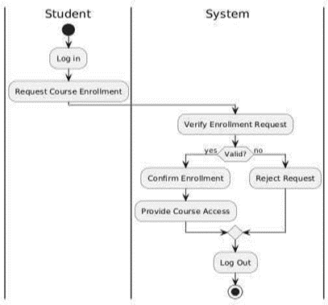
5.2 Activity diagram
Figure 5.2.1 Course Registration
Description:
This activity diagram illustrates the course registration process involving a student and the system.
The student initiates the process by logging into the system.
The system then displays the available courses, and the student selects the desired course.
Upon selection, the system checks the prerequisites and available slots.
If the prerequisites are met and slots are available, the system registers the student for the course and updates the database.
Finally, the system confirms the registration to the student.

Slide 18
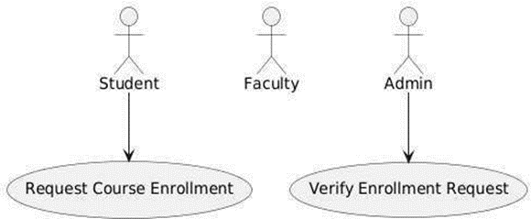
6. Use Case Diagrams
5.3.1 Course Enrolment for Student
Description:
This use case diagram illustrates the course enrolment process involving three primary actors: Student, Faculty, and Admin.
The process begins with the student submitting an Enrolment Request.
The admin is responsible for verifying the request through the Verify
Request. Once the request is verified, the Enrolment Confirmation is issued to the student.
Faculty may also be involved in the process for approval or additional verification steps, ensuring a comprehensive and structured enrolment procedure.

Slide 19
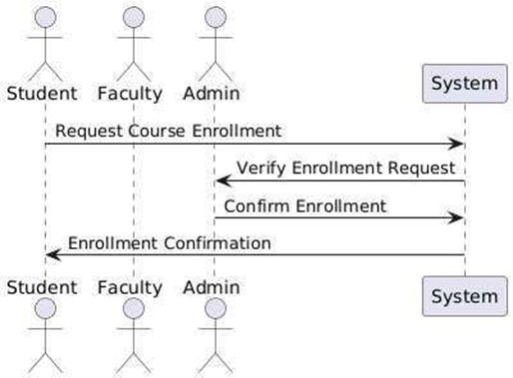
7. System Design & Database Design
Description:
This sequence diagram illustrates the course registration process involving three primary actors:
the Student, Faculty, and Admin.
The process begins with the student sending a course registration request to the faculty.
The faculty reviews and approves the request, forwarding it to the admin for final verification.
The admin confirms the registration, and a confirmation is sent back to the student, completing the registration process.
Figure 5.4.1 Course Registration Enrolment and Confirmation

Slide 20
8. Test Cases
Test cases define specific scenarios to be tested, including expected inputs and outputs.
Examples of test cases include:
User Authentication: Verify login functionality with valid and invalid credentials.
Course Management: Test course creation, modification, and deletion processes.
Data Management: Validate data entry, modification, and retrieval operations.
System Performance: Measure response times under varying loads to ensure the system meets performance criteria.

Slide 21
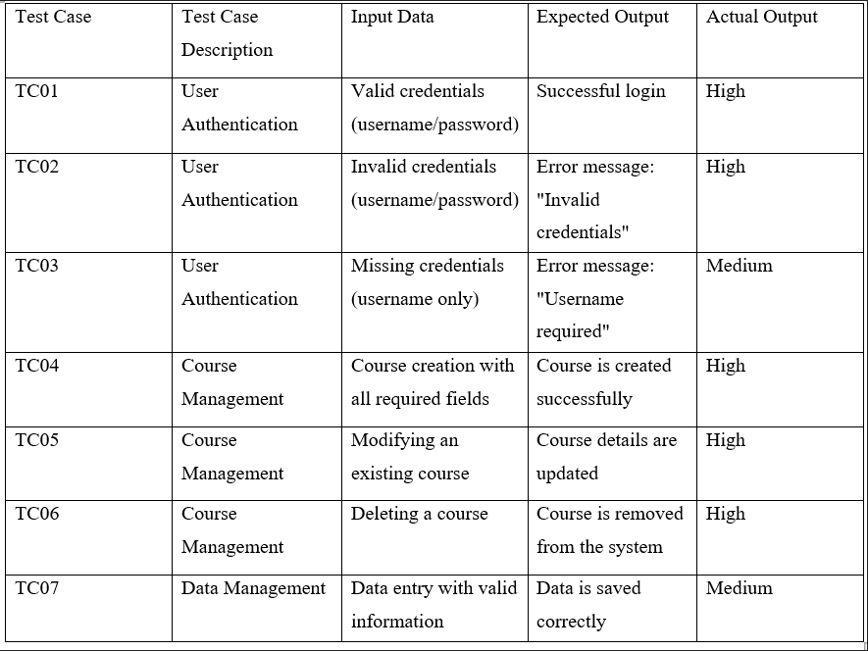
Table 7.3.1 Test Case Result

Slide 22
11.Conclusion
The digitalization journey of the MCA Department represents a pivotal transformation that has significantly enhanced its educational landscape, operational efficiencies, research capabilities, and overall student outcomes.
Through strategic investments in technology infrastructure, adoption of digital tools, and cultivation of a collaborative learning environment, the department has successfully navigated the challenges and opportunities presented by the digital age.
Central to the success of digitalization initiatives has been the focus on enhancing learning experiences for students.
This approach not only fosters deeper understanding of theoretical concepts but also cultivates critical thinking, problem-solving skills, and creativity essential for their future careers in the IT industry.
Administratively, digitalization has streamlined processes, reducing administrative burdens and optimizing resource allocation.
Automation of routine tasks such as course registration, scheduling, and grading has enabled faculty and staff to devote more time to academic support and strategic initiatives.
Integrated management systems have facilitated data-driven decision- making, enhancing transparency, accountability, and operational effectiveness within the department.

Slide 23
Furthermore, digitalization has positioned the MCA Department as a hub of research excellence by providing faculty and students with access to advanced research tools, databases, and collaborative platforms.
This has catalyzed interdisciplinary research collaborations and accelerated knowledge discovery in emerging fields like artificial intelligence, cybersecurity, and data science.
The increase in research outputs, publications, and partnerships underscores the department's commitment to advancing knowledge and innovation in the IT domain.
Inclusivity and accessibility have also been prioritized through digitalization efforts, ensuring that all students, regardless of physical abilities or learning preferences, can fully participate in and benefit from educational opportunities.
By adopting universal design principles and leveraging assistive technologies, the department has created an inclusive learning environment that supports diverse student needs and promotes equity in education

Slide 24
10.Open For Discussion
Current Challenges: Outline the existing challenges or inefficiencies in the MCA department that digitalization aims to address.
Proposed Digital Solutions : Implement a centralized system for managing student records, grades, attendance, and communication.
Online Learning Management: Use platforms for course management, online classes, and assignments submission.
Automated Administrative Tasks: Automate tasks such as admissions, scheduling, and faculty evaluations to streamline operations.
Data Analytics: Integrate tools for analyzing student performance, departmental metrics, and resource utilization.
Benefits of Digitalization : Efficiency: Reduced manual workload and faster processing of tasks.
Accessibility: Improved access to information and resources for both students and faculty.

Slide 25





9.Sample -Screenshots

Slide 26
REFERENCES
Bates, A.W. (2019). Teaching in a digital age. Guidelines for designing teaching and learning.
2. 2nd Edition. Retrieved from https://teachonline.ca/teaching-in-a-digitalage/teaching- in-a-digital age-second-edition
3. Coccoli, M., Guercio, A., Maresca, P., and Stanga nelli, L. (2014). Smarter universities: A vision for the fast-changing digital era. In Journal of Visual Languages & Computing, 25(6), 1003–1011.
4. Engen, B. K., Giæver, T. H., and Mifsud, L. (2015). Guidelines and regulations for teaching digital competence in schools and teacher education: a weak link? In Nordic Journal of Digital Literacy, 10 172–186.
5. Fojcik, M., M. K., Hegland, P. A., Kyte, L., Midtbo, T. G., Pollen, B., Sande, J. And Sande, O. 2020.
6. Johannesen, M., L., and Giaever, T. H. (2014). Notion in motion: Teachers’ digital competence. In Nordic Journal of Digital Literacy, 9(04), 300–312.
7. PricewaterhouseCoopers (2018). The 2018 digital university. Staying relevant in the digital age. Retrieved from https://www.pwc.co.uk/assets/pdf/the-2018-digitaluniversity-staying- relevant-inthe-digital-age.pdf
8. Raschke, C. A. (2003). The digital revolution and the coming of the postmodern university. Routledge.
9. Schuster, K., Gross, K., Vossen, R., Richert, A., and Jeschke, S. (2016). Preparing for industry 4.0 – Collaborative virtual learning environments in engineering education. In Engineering Education 4.0, 477–487. Springer, Cham.
10.Selwyn, N. (2014). Digital technology and the contemporary university: Degrees of digitization. Routledge.
11.Smeets, E. (2005). Does ICT contribute to powerful learning environments in primary education? In Computers & Education, 44(3), 343–355.

Slide 27
THANK YOU

